Slide 1
The Teach-back Communication Method
An ‘Always Event’ Part 1: The Basics
Notes:
Welcome to the evidence-based communication method known as teach-back. The training is divided into two parts – Part 1: The Basics will focus on several communication principles in preparation for Part 2: Teach-back.
“Always events” are defined by the Institute for Healthcare Improvement as “aspects of the care experience that should always occur when patients, their family members or other care partners, and service users interact with health care professionals and the health care delivery system.” http://www.ihi.org/Engage/Initiatives/PatientFamilyCenteredCare/Pages/AlwaysEvents.aspx
Who thinks that effective communication with our patients/residents/families should always occur? Does it?
What do you hope to learn about teach-back?

Slide 2
Part 1: The Basics - Objectives
Explain the importance of patient activation
Describe health literacy
Demonstrate the use of plain language
Notes:
At the conclusion of Part 1: The Basics training, you will be able to answer the following questions:
What is patient activation?
Why is patient activation important?
What is health literacy?
How do we use plain language in our communication with patients and families? You will have an opportunity to practice using plain language.
Though there are didactic/lecture portions within Parts 1 and 2 of the training, the majority of the training is a discussion about the basics and elements of teach-back followed by opportunities to practice the new skills.
I encourage your questions and comments throughout both sessions of the teach-back training.

Slide 3
Discussion
What consideration do you give health literacy in your interaction with patients?
Notes:
Let’s start with a question pertinent to the Teach-back basics training: What consideration do you give health literacy in your interaction with patients?

Slide 4
Are You Assessing the Health Literacy of Your Patients?
Assessing health literacy:
“How often do you have someone help you read hospital materials?”
“How confident are you filling out medical forms by yourself?”
“How often do you have problems learning about your medical condition because of difficulty understanding written information?”
https://www.stfm.org/fmhub/fm2004/September/Lisa588.pdf
Notes:
In an early study (2004), three screening questions were identified as effective in detecting individuals having inadequate health literacy:
“How often do you have someone help you read hospital materials?”
“How confident are you filling out medical forms by yourself?”
“How often do you have problems learning about your medical condition because of difficulty understanding written information?”
https://www.stfm.org/fmhub/fm2004/September/Lisa588.pdf
How could a patient’s response to even one of these questions guide you in your interaction with him/her?
More to come on the importance of health literacy.

Slide 5
Part 1: The Basics
Objective 1
Explain the importance of patient activation
Notes:
We will begin the discussion about the basics of teach-back by taking a look at patient activation and how it is relevant to teach-back.

Slide 6
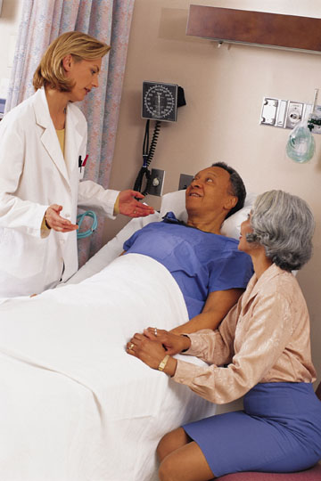
Patient/Resident Experience
What’s she saying? I sure hope my wife is getting this.
Blah blah blah, blah blah.
Any questions?
No, sounds good to me.
Notes:
What you see illustrated on this slide is the typical patient experience. George and his lovely wife Caroline have just learned from the cardiologist that George has heart failure.
In the right upper corner, you see what George is hearing as his cardiologist describes the pathophysiology of and treatment plan for heart failure, “Blah blah blah, blah blah.” After 5 minutes of explanation, the cardiologist asks, ”Do you have any questions?” Sounds good. Isn’t that what we do?
(Include your own example of asking the same question after providing patient education.)
The problem is in what George is actually thinking and how he responds. He says, ”No, sounds good to me.” But what is George thinking? ”What’s he saying? I sure hope my wife is getting this.”
(Share personal story in which you or your family member were the patient with the similar response. Ask for story from audience.)
What potential effects could George’s experience have in regard to his heart failure outcomes?
The question for us healthcare profesionals is ”why does this happen?”

Slide 7
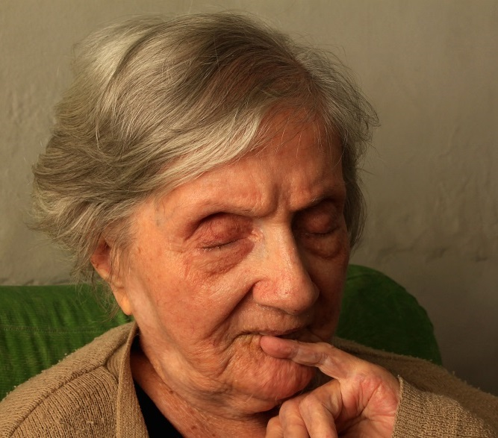
Patient experience
Patient factors:
Level of health literacy
Nervousness
Emotional response to the topic diagnosis
Health status
Healthcare provider factors:
Use of medical terminology
Limited time for discussion
Amount of information to communicate
Overestimating level of patient’s understanding
Notes:
Multiple factors can contribute to an ineffective exchange of information between a patient/resident/caregiver and healthcare professional:
Patient factors include not just an individual’s reading ability but his/her ability to read, understand and use the healthcare information that we as healthcare professionals provide. A factor otherwise known as health literacy.
(Share experience taking your personal computer or car in for repairs. When it is repaired and you ask what was wrong, do you understand what you were told? Could you repeat it to someone else? Our experience with the computer tech or the mechanic is similar to the healthcare experience of many, if not most, of our patients with patient education.)
More and more we are seeing individuals in which English is their second language. How does that impact their ability to process the information that we are sharing?
Nervousness. In this case George just learned that he has been diagnosed with the same condition that led to his father’s death. So what do you think is on his mind? Or maybe he is concerned that the daughter who is picking up he and his wife will be late for work if they don’t leave soon. Remember our autonomic fight-or-flight response? In situations of acute stress, the body produces hormones that disrupt the process by which the brain collects and stores memories. When a person is nervous – he/she does not learn – the body is preparing for a physical response and is not able to mentally absorb information. At best, he/she has a difficult time learning and remembering.
We’ve already touched on the impact of learning when there is an emotional response to the information shared.
Consider the physical condition of the individual to whom you are providing the information. The weaker and more frail the individual is, the more difficult the learning process will be for them. A patient’s ability to hear is a major factor in their ability to learn. What are they hearing?
Let’s talk about some of the factors that we as healthcare professionals/providers bring to the conversation that may compound a patient’s ability to “hear” what we are saying.
What is the vocabulary that we are using as we provide the discharge instructions? Is it understood?
Do we give the impression that we have time for them and their questions? Or are we standing at the bedside frequently looking at the clock? Or worse yet, slowly backing out of the room. We may have wonderful patient education materials that we are discussing but what is the message that the patient and their loved one receive?
Sometimes we just have too much information for our patients/residents to receive at one time. What is the absolute essential thing they need to know at this time? Can additional details be provided at their next touchpoint with the healthcare system? That does require a system-level approach to patient education.
Last but definitely not least, we overestimate the level of a patient’s understanding.
This is not about dumbing down the conversation but rather making the conversation relevant to the patient/resident/caregiver.

Slide 8
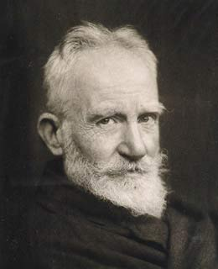
The problem with communication is the illusion that it has occurred.
George Bernard Shaw
Notes:
George Bernard Shaw years ago recognized the problem with communication. “The problem with communication is the illusion that it has occurred.” Or as one patient advocate once said, “what’s clear to you…is clear to you”.

Slide 9
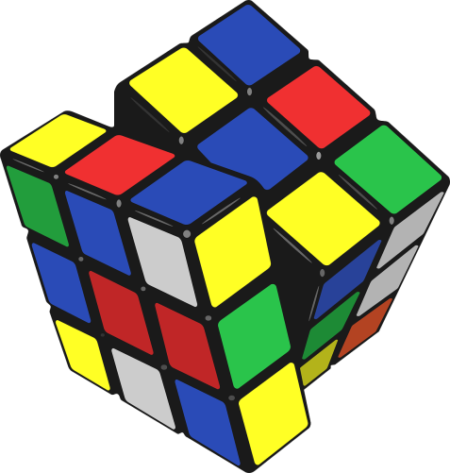
Patient Activation: What it is
Patient activation refers to a patient's knowledge, skills, confidence, and willingness to manage his or her own health and care
“Health Policy Brief: Patient Engagement,” Health Affairs, February 14, 2013.
Teaching problem-solving skills related to the self-management of their chronic condition
Bodenheimer T, Lorig K, Holman H, Grumbach K. Patient self-management of chronic disease in primary care. JAMA. 2002;288(19):2469-75.
Notes:
We have spent several minutes discussing the typical patient communication experience and several factors that contribute to that experience. Our focus now is the goal of our patient/resident/caregiver education . . .
and that is that he/she has not only the knowledge, but ultimately the skills, and confidence, along with the willingness to manage his or her health and health care. All four elements are necessary if a patient is to successfully manage his/her health and become an active partner in the healthcare he/she receives. The ultimate goal of patient education must be a patient/caregiver that not only has the knowledge, i.e., has the right answers to our questions but they have the skills and confidence to use his/her glucometer, nebulizer, or ability to fill a medication planner. And importantly, they are willing to do what they “know.”
The goal of patient education is that our patients/residents/caregivers over time develop the problem-solving skills needed to manage their health.

Slide 10
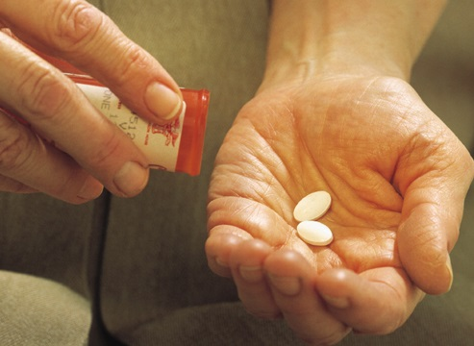
The Patient Activation Continuum
“The doctor knows my medicines”
“I take a blood pressure pill . . .”
“Doctor, I have a question . . .”
Notes:
Patient activation occurs over time. The passive patient/resident is just that. They have assumed limited responsibility – ownership – of their health outcomes. I am sure you have had the conversation with a patient whose response to your question about what medications he/she takes is, “I don’t know. The doctor knows my medicines.” This would be the comment made by a patient who has assumed a very passive role in his/her health and healthcare. These patients have low levels of activation.
The engaged patient takes their medication and may even know why it was prescribed but they may not know that the muscle cramps they were experiencing for the past week were due to the statin they are taking. They would more than likely wait for their next scheduled appointment because “that is when the doctor told me to come back.” Engaged patients may be “compliant” with their medication regimen and treatment plan but may not be able to tell you which symptoms, if they occur, would require notifying his/her provider.
The activated patient is the individual who is on the search for information, wanting to learn more, and comes with his/her questions. They are individuals who bring their notebook of questions to their post discharge follow-up appointment.
What difference could a better understanding of patient activation make for your patients/residents? For you? Interventions will be most effective if the specific contributing factor or factors are addressed. For example, providing patient education materials to an individual who is simply unwilling to assume their role in their healthcare will not produce the positive outcome you would like to see. The problem is that he/she is unwilling to assume responsibility for their health. A patient nervous about giving themselves insulin does not necessarily need more instruction but rather encouragement and support.

Slide 11
More Activated Patients Receive Better Care
As activation levels increase, individuals become:
More adherent to medications
More likely to eat healthier and engage in physical activity
More engaged with their clinicians
Less likely to use the ER
More present in the workforce and more satisfied in the jobs
Patients who are more knowledgeable, skilled, and proactive when they arrive for a clinical interaction are more likely to leave with their needs met
Greene J, Hibbard JH, Sacks R, Overton V. When seeing the same physician, highly activated patients have better care experiences than less activated patients. Health Affairs, 32, no.7 (2013):1299-1305.
Notes:
The more activated an individual is in their health and healthcare, the better the care the individual receives.
He or she is more adherent to the prescribed medication regimen.
Activated individuals make better life style choices by eating healthier and engaging in more physical activity.
They are more engaged with their clinicians, asking questions about their health and developing plans of care with their providers.
Activated individuals utilize the emergency department less frequently. What do you think could be the reason for this? (All the above. They are taking their medications – they have a healthier life style – have a plan of care that they helped develop.)
Something that relates to us here participating in this training is that more activated individuals have less job absenteeism and a higher degree of job satisfaction. Why do you think that is? (Healthier.)
Most importantly, higher activated patients are more likely to leave a clinical appointment (for that matter, any healthcare encounter) with their needs met. Isn’t that what we want – patients/families leaving satisfied with the care they receive?

Slide 12
Patient Activation: What it’s not
More patient education
Adams KG, Greiner AC, Corrigan JM, eds. Report of a summit. The 1st annual crossing the quality chasm summit: a focus on communities; Jan 6-7, 2004. Washington, DC: National Academies Press; 2004.
patient engagement interventions designed to increase patient involvement and promote positive patient behavior
Using bedside change-of-shift reports
Providing health education and health literacy classes
Surveying patients about care experience
Involving patients and families in patient and family advisory councils, governance, and other committees
Patient portal connections to electronic health records
A Leadership Resource for Patient and Family Engagement Strategies. Health Research & Educational Trust, Chicago: July 2013. Accessed at www.hpoe.org
Notes:
Let’s briefly discuss what patient activation is not.
Patient education is an important element in assisting patients to become activated in their health and healthcare but it is not enough.
In the same way, patient engagement activities such as bedside change-of-shift reports, patient surveys, patient/family councils, and patient portals to electronic health records may support patients in the activation process but they do not necessarily move a patient from passivity to becoming actively engaged in their healthcare.

Slide 13
Discussion
Why is patient activation important?
Notes:
We’ve covered a considerable amount of information about the patient healthcare experience and patient activation as a basic element of teach-back. I want to make sure that how I have presented the information is helpful.
If you were to go back to your unit/floor/department/facility and a colleague asked you the reason why you have started talking about patient activation ad nauseum, what is one reason that you would give regarding the importance of patient activation for the patients/residents/families you serve? (Speaker is modeling teach-back method with this question.) (Encourage discussion as time allows.)

Slide 14
Objective 2
Part 1: The Basics
Describe health literacy
Notes:
We’ve spent some time discussing the importance of patients becoming activated in their health and healthcare. Generally speaking, they have better outcomes.
Prior to that we spent some time exploring factors that influence the patient healthcare experience. At this time, we will take a closer look at how we provide information to patients/residents/families – specifically addressing health literacy.

Slide 15
Health Literacy
“The degree to which individuals have the capacity to obtain, process, and understand basic health information and services needed to make appropriate health decisions.”
Kutner, M., Greenberg, E., Jin,Y., and Paulsen, C. (2006). The Health Literacy of America’s Adults: Results From the 2003 National Assessment of Adult Literacy (NCES 2006–483). U.S. Department of education. Washington, DC: National Center for Education Statistics.
Only 12% of literate Americans are proficient in understanding health information
Minnesota Partnership for Health Literacy
Notes:
A patient’s level of health literacy will be affected not only by his/her ability to read but also by an individual’s ability to access health information – to process the information – and determine what it means - in order to make appropriate health decisions.
Less than one out of ten literate Americans are proficient in understanding health information. Did you know that after a healthcare encounter, patients forget up to 80% of what you tell them? If they do remember, only half of what they remember is correct.
Think back to our patient activation discussion. What was one of the key elements of becoming an activated patient? KNOWLEDGE. Knowledge is essential. If a patient does not remember our instructions or what he/she remembers is incorrect, how well spent is our time when providing education about diabetes, heart failure, medications, and the list goes on and on?
Limited health literacy is associated with medication errors, increased health care costs, and inadequate knowledge and care for chronic health conditions. This is sounding rather familiar – isn’t it?
Low health literacy may also have negative psychological effects. One study found that those with limited health literacy skills reported a sense of shame about their skill level. As a result, they may hide reading or vocabulary difficulties to maintain their dignity. An individual is unlikely to ask a question or ask for clarification if they are afraid of sounding foolish. Consider your own willingness to ask a question if you think it might be a ‘stupid’ question.

Slide 16
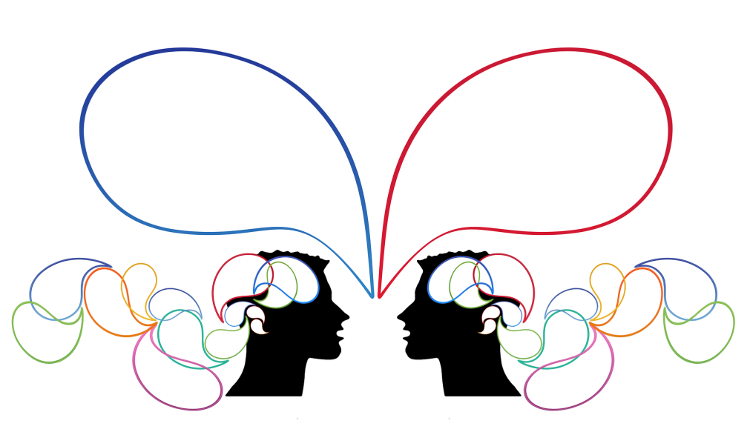
Health Literacy: Universal Communication Principles
Everyone benefits from clear information
Many patients are at risk for misunderstanding but it is difficult to identify them
Knowing the patient’s level of education does not ensure patient understanding
Use plain language!
“This is what I HEARD.”
“This is what I MEANT.”
Notes:
Like the universal infection prevention precautions that we employ in the care of our patients/residents, that is, wearing gloves and washing our hands, UNIVERSAL COMMUNICATION PRINCIPLES benefit everyone.
Everyone benefits from clear information including the sender and receiver of the information.
It is difficult to identify patients who are at risk for misunderstanding. They may compensate by saying that the lenses in their glasses need changing; or they will review the information when they get home; or simply say, “I don’t have any questions.”
Knowing the patient’s level of education does not ensure patient understanding. Remember your experience with the mechanic – and you are a highly educated person.
Bottom line – our patients/residents need us to use plain language.

Slide 17
Discussion
As healthcare professionals, why should we be concerned about health literacy?
Notes:
We’ve briefly discussed health literacy. How would you describe health literacy to a patient/resident or family member? (Speaker is modeling teach-back method with this question.) (Encourage discussion as time allows.)
As healthcare professionals, why should we even be concerned about health literacy?

Slide 18
Objective 3
Part 1: The Basics
Demonstrate the use of plain language
Notes:
I previously mentioned that using plain language is one of the universal communication principles that improves patients’ health literacy. So let’s take some time to develop a fuller understanding of plain language and how to use it.

Slide 19
Plain Language
A way of communicating that everyone in your audience can easily understand
Relevant to the reader/listener
Clear and concise
Easy to follow
Conversational and direct
Designed to be inviting and help readers find important information
Plain Language Association International.
http://plainlanguagenetwork.org/index.html
Notes:
Plain language is simply communicating in a way that everyone can easily understand.
It is relevant to the listener or in the case of printed materials – the reader.
It is clear, concise and easy to follow.
It is conversational – not authoritative, i.e., that you are the one with the education and knowledge.
Plain language is helpful. Consider our earlier discussion of your experience with the computer tech or mechanic. How could the use of plain language have benefitted you? How could the use of plain language – versus medical terminology – benefit your patients/residents?

Slide 20
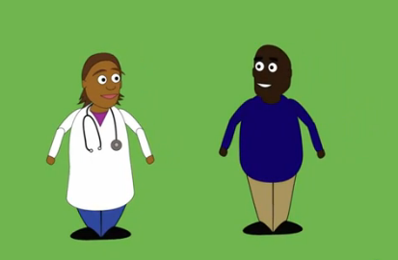
Keep It Simple for Safety
http://www.youtube.com/watch?v=XiBZjpy3ibs
Notes:
Let’s take a quick look at using plain language. https://www.youtube.com/watch?v=XiBZjpy3ibs
What caught your attention about using plain language?
How easy do you think using plain language will be for you?

Slide 21
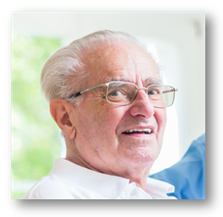
Practice: Plain Language
“I would like you to meet . . .”
James, age 78, lives at home with Martha, his wife of 48 years. He was admitted to the hospital with shortness of breath . . .
Notes:
Now is your opportunity to practice using plain language. Let me introduce you to James . . .
James is 78 years old. He lives at home with his wife Martha. They have been married for 48 years. James was admitted to the hospital with shortness of breath . . .
James was just informed by the cardiologist that he has heart failure. (Next slide.)

Slide 22
Practice: Plain Language
Heart failure definition
An acute or chronic inability of the heart to maintain adequate blood circulation to the peripheral tissues and the lungs, usually characterized by fatigue, edema, and shortness of breath. It has many causes, including coronary artery disease, hypertension, and cardiomyopathy. It is also called congestive heart failure.
The American Heritage® Science Dictionary Copyright © 2005 by Houghton Mifflin Company. Published by Houghton Mifflin Company.
Notes:
And this is the definition the cardiologist provided James when asked, “What is heart failure?”
(Ask for volunteer to read the definition.)
Is this an accurate description of heart failure? What is the problem with this definition?
James has had limited health problems throughout his life. What do you think James understood about heart failure from this definition?
What could be done to improve James’ understanding of heart failure? (Next slide)

Slide 23
Practice: Plain Language - 1
Medical Terminology | Plain Language
Acute
Chronic
Peripheral tissues
Fatigue
Edema
Hypertension
Cardiomyopathy
Heart failure
Resource:
Plain Language Medical Dictionary University of Michigan
http://www.lib.umich.edu/plain-language-dictionary
Notes:
This is your opportunity to assist James in gaining a better understanding of his heart failure. We will spend the next 10 minutes (adjust time as needed but always allow time for report back and group discussion) developing plain language for the medical terminology used by the cardiologist.
Each of you have received a TEACH BACK—PLAIN LANGUAGE PRACTICE WORKSHEET. Using page 1 of the Worksheet, write down the “plain language” word or words that you would use to explain heart failure to James. Hint: There may be more than one plain language word for the medical terms. (This activity can be completed individually or in groups of 2-3, depending on size of audience. The dialogue that occurs within the small groups is valuable learning.)
(If the room arrangement allows, walk around to hear the discussion within the small groups. Do not provide your plain language words if asked. Allow the participants to struggle - using plain language is more difficult than people think. Pull the participants back together when the majority of the small groups have completed the activity.)
Question: What was your initial response to using plain language? (The responses are generally related to how difficult it is.)
Review each medical term asking for the plain language vocabulary identified by participants.
(Depending on the need, this activity can be modified by using a different scenario, diagnosis, or medical terminology to meet the specific needs of the participants.)

Slide 24
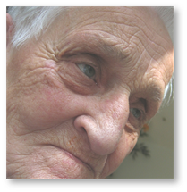
Practice: Plain Language
James, age 85, has lived at your facility since his wife died several years ago. His condition has deteriorated over the past several months. It is time to revisit his healthcare directive and have a conversation about his health care preferences.
Notes:
(If time allows or as needed, this activity provides additional experience using plain language. Social workers particularly appreciate this exercise.)
We meet James some years later. James is now 85 years of age and has lived at a long term care facility since his wife died several years ago. His condition has deteriorated over the past several months. It is time to revisit his healthcare directive and have a conversation about his health care preferences.
(Next slide)

Slide 25
Practice: Plain Language - 2
Medical Terminology | Plain Language
Exacerbation
Transported
Cardiopulmonary
Resuscitation
Healthcare directive
Consultation
Palliative care
Symptoms
Resources:
Plain Language Medical Dictionary University of Michigan
http://www.lib.umich.edu/plain-language-dictionary
Notes:
What you see on the screen are some terms that could be used in a discussion about preferences of care. This is your opportunity to assist James to gain a better understanding of healthcare directives and the purpose of them.
This list of terms are found on page 2 of the TEACH BACK—PLAIN LANGUAGE PRACTICE WORKSHEET. (This activity can be completed individually or in groups of 2-3 depending on size of audience. The dialogue that occurs within the small groups is valuable learning.) Using the Worksheet, write down the “plain language” word or words that you could use in place of the medical terminology. Hint: There may be more than one plain language word for the medical terms.
(If the room arrangement allows, walk around to hear the discussion within the small groups. Do not provide your plain language words if asked. Allow the participants to struggle – using plain language is more difficult than people think. Pull the participants back together when the majority of the small groups have completed the activity.)
Question: How did this exercise compare to the first exercise relating to heart failure? (Frequently the responses are that this exercise, related to healthcare directives, is more difficult than the first exercise.)
Review each medical term asking for the plain language vocabulary identified by participants.

Slide 26
Discussion
How can you use plain language?
Notes:
Question: How do you envision using plain language in your practice as a nurse – social worker – provider . . . etc.?

Slide 27
Discussion
We’ve covered a considerable amount of information today, and I want to make sure that I clearly explained the value of providing relevant patient education. What explanation would you give a provider who questions the benefit of using plain language?
Notes:
We’ve covered a considerable amount of information today, and I want to make sure that I clearly explained the value of providing relevant patient education. What explanation would you give a provider who questions the benefit of using plain language?

Slide 28
Part 1: The Basics
FINISH LINE!!!
Notes:
(Skip this and the next slide if Part I and 2 are provided on the same day.)
Thank you for enthusiastically participating in Part 1 of the teach-back basics training. I would appreciate hearing about your experiences using plain language, including any patient/resident/caregiver feedback. Don’t hesitate to contact me with your questions regarding health literacy and the use of plain language.
Please leave your completed evaluation for this portion of the teach-back training on the ___________.

Slide 29
Contact Information
Add
your contact information
This material was prepared by the Great Plains Quality Innovation Network, the Medicare Quality Improvement Organization for Kansas, Nebraska, North Dakota and South Dakota, under contract with the Centers for Medicare & Medicaid Services (CMS), an agency of the U.S. Department of Health and Human Services. The contents presented do not necessarily reflect CMS policy. 11S0W-GPQIN-ND-C3-79/1116
Notes:
(Do NOT use this slide if Parts 1 and 2 are used on the same day. USE if Parts 1 and 2 are scheduled on different days. Edit as appropriate)

Slide 30
Recharge
Notes:
(USE this slide if a break is scheduled between Part 1 and Part 2. DO NOT use if Parts 1 and 2 are scheduled on different days.)
Time to recharge. Let’s take a 15 minute break before we start the section on teach-back.

Slide 31
The Teach-back Communication Method
An ‘Always Event’
Part 2: Teach-back
Notes:
Our focus in the Part 2 training is the evidence-based communication method known as teach-back. We’ve already established the fact that effective communication with our patients/residents/caregivers should be considered an “always event.” A practice that should always occur.
We’ve discussed the importance of patient activation, health literacy, and the use of plain language with our patients. We will now focus on the communication method known as “teach-back.”

Slide 32
Part 2: Teach-back - Objectives
Describe teach-back and the ten key elements of teach-back
Demonstrate effective use of teach-back communication skills
Develop personal implementation plan for utilizing teach-back
Notes:
At the conclusion of the Part 2: Teach-back training, you will be able to answer the following questions:
What is teach-back? What are the key elements that make teach-back an effective communication method?
How do you use teach-back when communicating with patients/residents and families? Like plain language, you will have an opportunity to practice using teach-back.
What is your plan to personally utilize teach-back when communicating with patients/residents and families?
Again I encourage your questions and comments throughout this session of the training.

Slide 33
Question
Part 2: Teach-back
Are you using teach-back?
Notes:
So let’s start with a question, “Are you currently using teach-back as a communication method with your patients and families?” (Proceed to the next slide.)

Slide 34
Are You Using Teach-Back? Survey
http://www.ahrq.gov/sites/default/files/wysiwyg/professionals/quality-patient-safety/patient-family-engagement/pfeprimarycare/AreYouUsingTeachBack.pdf
Have you reviewed any teach-back materials?
Do you typically use the teach-back process with your patients/residents?
Are the patient/resident teach-back materials available to patients?
Is the use of teach-back encouraged in your practice/organization?
Notes:
Let’s take a quick survey: Each of you have received a copy of a four-question survey titled, “Are You Using Teach-back?”. The purpose of this tool is to assess the use of teach-back. It will help us understand how and if teach-back is being used on your unit [in our department/facility] [across our organization].
With a show of hands, prior to this event who had reviewed any teach-back materials? (Record response.)
Who typically uses the teach-back process with patients/residents? (Record response.)
Are patient/resident teach-back materials available to patients? (Record response.)
Is the use of teach-back encouraged your unit [in your department/facility] [across our organization]?
We just determined how teach-back is currently utilized on your unit [in your department/facility] [across our organization]?

Slide 35
Objective 1
Part 2: Teach-back
Describe teach-back and the ten key elements of teach-back
Notes:
The focus of Section 2 is using teach-back. At the conclusion of this section, you will be able to describe teach-back and the ten key elements of teach back.

Slide 36
Teach-Back: What it is
An evidence-based communication technique used to help patients remember and understand important information
Involves:
Asking the patient to explain in their own words or demonstrate the information discussed
Gives the patient ownership regarding his or her healthcare
Notes:
Teach-back is an evidence-based communication method that is used to help patients remember and understand important information.
Teach-back involves asking the patient to explain in their own words the information that was shared with them. If it is a skill that was taught, then teach-back would involve the patient/caregiver demonstrating the skill that was taught, e.g., the use of a glucometer, inhaler, nebulizer, etc.
Teach-back not only gives the patient ownership of his/her healthcare but empowers them to make informed decisions.
Teach-back is not a test of the patient’s learning ability but rather the healthcare professional’s ability to communicate in a way that is relevant to the patient/resident/caregiver, etc.

Slide 37
Teach-Back: What it is
Medication Reconciliation
Information Reconciliation
Notes:
It may be helpful to consider teach-back as a method of reconciling the information shared with a patient/resident/caregiver with the information that was actually received by the patient/resident/caregiver.
Is what was taught or demonstrated to the patient, what the patient actually received or understood?
This sounds very similar to medication reconciliation, doesn’t it? Is the medication prescribed by the provider, the medication the patient is taking?
Teach-back is information reconciliation.

Slide 38
Teach-Back: What it is
What it is not: A test of the patient
“Do you understand?”
“Do you have any questions?”
What it is: How well you explained a concept
“We covered a lot of information today and I want to be sure I explained everything clearly, what are some signs when you should call the doctor?”
Notes:
Teach-back is not a test of the patient. It is a way for you to make sure your patients understand what you tell them.
Teach-back is assessing how well you explained a concept – how well you relayed the information. Was it relevant to the receiver? Was it conversational or directive?
Let’s compare the questions on the slide: What is the difference between “Do you understand?”/”Do you have any questions?” and “We covered a lot of information today and I want to be sure I explained everything clearly, what are some signs when you should call the doctor?”
Which question(s) most closely resemble(s) what you commonly use?
Which question(s) will provide you a better understanding of what the patient/resident/caregiver actually received?

Slide 39
Teach-back: Information Reconciliation
Share
Ask
Listen
Share Again
Ask Again
S-A-L-S-A
Information
Notes:
An easy way to remember the teach-back process is S-A-L-S-A!
S – Share the information
A – Ask or assess understanding by asking questions that place the focus on the your ability to provide the information
L – Listen to the response
S – Share the information again if needed – using different vocabulary. Consider relevance.
A – Ask again
Why is teach-back important? Evidence suggests that patients forget up to 80% of what you tell them. If they do remember, only half of what they remember is correct.
So spend several minutes discussing the elements that make teach-back such an effective communication method.

Slide 40
Teach-Back: 10 Elements
Responsibility is on the healthcare professional.
Use a caring tone of voice and attitude
Display comfortable body language and make eye contact
Use plain language, not medical terminology
“The doctor has changed how much medicine you should take . . .”
Handout
10 Elements of Competence
For Using Teach-back
Effectively
Notes:
In your packet of handouts, you received one titled “10 Elements of Competence for Using Teach-back Effectively.”
The overarching principle is that successful communication is the responsibility of the professional!
Create a level of comfort in which the patient/resident/caregiver is able to receive the information you are providing. This is accomplished by using a caring tone of voice and attitude; sitting – making eye contact – using plain language. This creates a sense of collaboration between the provider and patient/resident/caregiver; an environment in which the information that you are sharing can be received.

Slide 41
Teach-Back: Ten Elements
Ask the patient to explain back using their own words
“Tell me what you will do when you get home.”
Use non-shaming, open-ended questions
“Because you have several new pills,
what will you do if you forget to take
them one morning?”
Notes:
Ask the patient to explain back in their own words the instructions they received using non-shaming, open-ended questions.
For example: “Tell me what you will do when you get home.” Another example could be, “I’m sure your daughter will be interested in your visit today, what will you tell her about the new diabetes pill that you will be starting?”
Or what you see on the screen: “Because you have several new pills, what will you do if you forget to take them one morning?”
How do these questions provide you a better understanding of what teaching the patient/resident/caregiver actually received versus using the question, “Do you have any questions?”

Slide 42
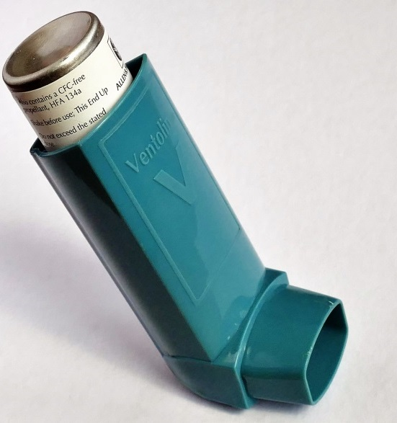
Teach-Back: Ten Elements
Avoid asking questions that can be answered with a simple yes or no
“Do you know how to use an inhaler?”
If the patient is not able to teach-back correctly, explain again and re-check
Emphasize that the responsibility to explain clearly is on you
“What are some signs you need to watch for that tell you when you need to call your doctor?”
Notes:
Avoid asking questions that can be answered with a simple yes or no. How many patients who use inhalers would tell you that they know how to use an inhaler? How many patients use an inhaler correctly?
In one Texas study (2014) of 145 patients using epinephrine autoinjectors or inhalers, only 7 percent of inhaler users demonstrated perfect technique and 63 percent missed three or more steps. None of the factors examined in this study, including clinic site, age and education level, impacted the rates of correct inhaler use. https://medicalxpress.com/news/2014-12-patients-inhalers-epinephrine-autoinjectors-correctly.html
What potential difference could the use of teach-back have for these patients?
If the patient is not able to teach-back or demonstrate the skill correctly – explain and/or demonstrate again followed by an open-ended question to assess his/her comprehension.
Emphasize the fact that the responsibility to explain is clearly on you.
“What are some signs you need to watch for that tell you when you need to call your doctor?”

Slide 43
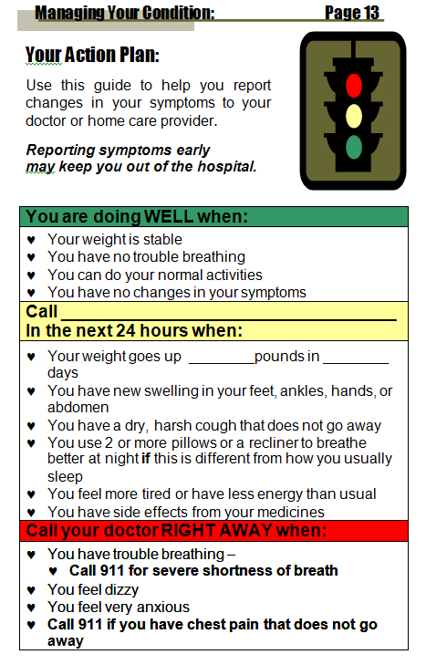
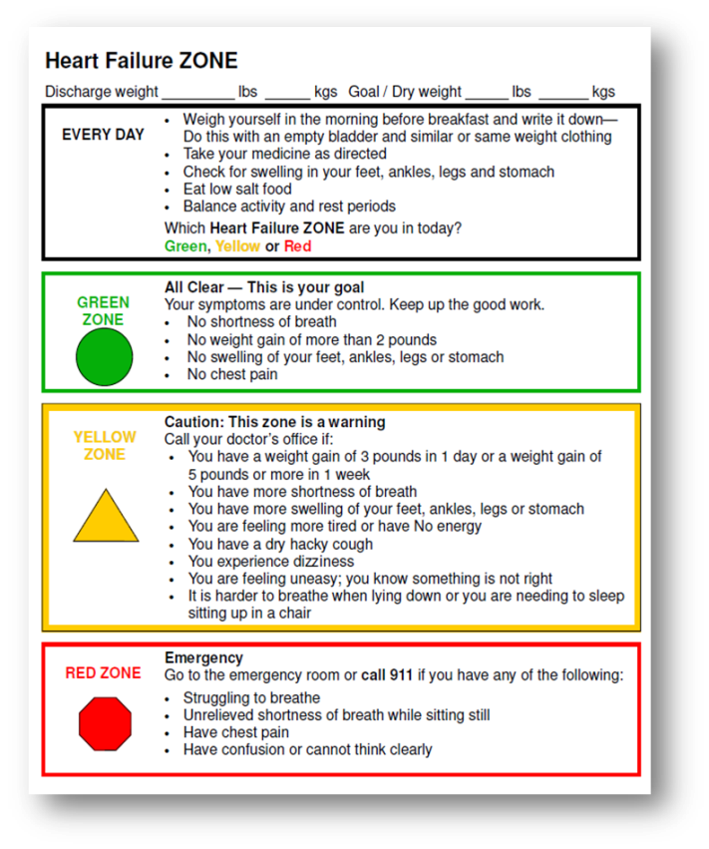
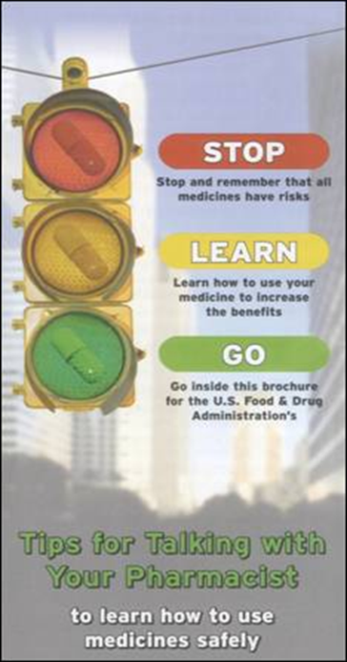
Teach-Back: Ten Elements
Use reader-friendly print materials to support learning
Document use of and patient response to teach-back
Notes:
Use reader-friendly print materials to support learning. On the screen are several examples of reader-friendly patient education resources.
What is the common theme that makes these resources so well received by patients? Answer: Traffic lights.
The average individual understands a conversation about symptoms when related to traffic lights. For example: For a heart failure patient, a stable weight without ankle or abdominal swelling is a ‘go’ – a green light. It is good. A 2-3 lb. weight gain overnight is something to be concerned about – a yellow caution light suggesting a phone call to their provider. Chest pain requires immediate attention. It is a red light condition. Stop and call 9-1-1.
Documentation of patient education using teach-back is important. It is particularly important if there is any risk of litigation. It is no longer acceptable to document “patient verbalized understanding” when he/she simply shook his/her head to the question, “Do you have any questions?”

Slide 44
Teach-Back: Summary
Asking patients to repeat in their own words what they need to know or do, in a non-shaming way
Not a test of the patient, but of how well you explained a concept
A chance to check for understanding and, if necessary, re-teach the information
Information Reconciliation!
Notes:
So, what is the teach-back technique?
Basically it is asking patients to repeat back in their own words what they understand from what they’ve been told. It is NOT a test. It is a way to let you know how well you’ve explained a concept. And, it needs to be completed in a non-shaming way. It is important that the patient recognizes it is to make sure you explained everything correctly.
Using teach-back provides you with the opportunity to confirm what the patient really understands and re-teach if necessary….right there…while they are still in the office with you. Doing this in real time can help reduce potential medication errors and mistakes with care instructions.
Teach-back is a communication method that ensures information reconciliation!

Slide 45
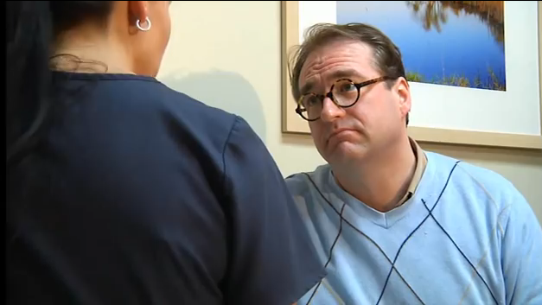
Teach Back: Demonstration
http://www.youtube.com/watch?v=2N0gCzdVFnM
Notes:
Let’s take a look at how teach-back is used by a nurse with an asthmatic patient regarding the use of an inhaler. Using the Teach-back Observation Tool as a guide, note use of the various teach-back elements.
After the video, ask the training participants which teach-back elements they observed in the video.

Slide 46
Discussion
What is teach-back and several key elements of teach-back?
Notes:
We’ve discussed teach-back and the various key elements of teach-back, how would you describe teach-back to a patient? (Speaker is modeling teach-back method with this question.) (Encourage discussion as time allows.)

Slide 47
Objective 2
Part 2: Teach-back
Demonstrate effective use of the teach-back communication skills
Notes:
We’ve talked about teach-back and seen teach-back demonstrated, it is now time to practice the use of teach-back.

Slide 48
Practice: Using Teach-back
James, age 85, has lived at your facility since his wife died several years ago. His condition has deteriorated over the past several months. It is time to revisit his healthcare directive and have a conversation about his health care preferences.
Notes:
Let’s go back to James. He is 85 years old and has lived at your facility since his wife died several years ago. His condition has deteriorated over the past several months. It is time to revisit his healthcare directive and have a conversation about his health care preferences.
Using teach-back, the Nurse provides education to James regarding his health care preferences and possible need for a transfer to the hospital.

Slide 49
Teach-Back: Practice Time: 10 minutes
Organize into groups of 2-3. Decide who will be James , the Nurse providing the education to James, and the Coach, i.e., observer.
Using teach-back, the Nurse provides education to James about his need for a transfer to the hospital. Consider the terms: exacerbation, transported, cardiopulmonary resuscitation, healthcare directive, consultation, palliative care, and symptoms.
Partners discuss teach-back technique using 10 Elements of Competence For Using Teach-back Effectively. What open-ended questions were used?
Switch roles. Nurse provides education to James about what he can do to stay out of the hospital. Observations?
Notes:
Organize into groups of 2-3 (preferably 3). In your group, determine who will be James, the Nurse providing the education to James, and the Coach, i.e., observer.
Using teach-back, the Nurse provides education to James about his need for a transfer to the hospital. Consider the plain language terms that you will need to use for exacerbation, transported, cardiopulmonary resuscitation, healthcare directive, consultation, palliative care, symptoms.
The Coach, as the observer will use the 10 Elements of Competence For Using Teach-back Effectively handout as a reference for coaching the nurse.
Nurse - you have 5 minutes to have this discussion with James. James - be in character. Coaches - note the teach-back key elements that the Nurse used in his/her discussion with James.
(After the five minutes, ask the Nurses how the experience was for them. Ask the James what they were thinking. Ask the Coaches for their observations. 5 minutes. Repeat the cycle three times or until each participant has an opportunity to assume the three roles. Total time for activity approximately 30-35 minutes. Note: The discussion between the role playing is essential for the learning of teach-back.)
(Modify the teach-back practice scenario as needed for your audience.)

Slide 50
Objective 3
Part 2: Teach-back
Develop personal implementation plan for utilizing teach-back
Notes:
So how confident are you feeling about using teach-back with the patients/residents for whom you provide care?
Conviction and confidence scales are an evidence-based method of determining how convinced an individual is regarding the importance of the information or skill that was taught. In our case, that would be the use of teach-back. (Next slide.)

Slide 51
Conviction and Confidence Scale
On a scale from 1 to 10, how convinced . . .
On a scale from 1 to 10, how confident are you . . .
How often do you ask patients/residents to explain back . . .
Check all the elements of effective teach-back you have used . . .
http://www.teachbacktraining.org/assets/files/PDFS/Teach%20Back%20-%20Conviction%20and%20Confidence%20Scale.pdf
Notes:
So just how confident are you feeling about using teach-back?
Intermittent use of the Always Use Teach-back! Conviction and Confidence Scale, e.g., now – before you use teach-back and __ months later and again __ months later will enable you as an individual and us as an organization to determine what follow-up coaching and/or training is needed. Over time, this will enable the measurement of teach-back capacity and utilization for you and within and across your organization.
For today, write your name on the Conviction and Confidence Scale. Check the Before circle and write in today’s date.
Question #1: On a scale from 1 to 10, how convinced are you that it is important to use teach-back (ask patients to explain key information back in their own words??
Question #2: On a scale from 1-10, how confident are you in your ability to use teach-back (ask patients to explain key information back in their own words)?
Question #3: How often do you ask patients to explain back, in their own words, what they need to know or do to take care of themselves?
Question #4: Check all the elements of effective teach-back you have used more than half the time in the past work week. For most of us that question may be left blank since we have just started the teach-back training in our organization.

Slide 52
Discussion
How will you incorporate teach-back into your care for your patients/residents?
Notes:
What are some ways that you plan to incorporate teach-back into how your care for your patients/residents?
What are some ways that you can help each other as you use teach-back?

Slide 53
Finding teach-back resources
Includes an
Interactive
Teach-back
Module
http://www.teachbacktraining.com/coaching-to-always-use-teach-back
Notes:
If you are interested in learning more about teach-back or would like further review, the Always Use Teach-back! website is a one-stop website for teach-back.
(An exhaustive list of teach-back resources is included in the teach-back module.)

Slide 54
Discussion
We’ve covered a considerable amount of information today, and I want to make sure that I clearly explained the value of teach-back. What benefits does utilizing teach-back provide patients/residents?
Notes:
We’ve covered a considerable amount of information today, and I want to make sure that I clearly explained the value of teach-back. What explanation would you provide a curious provider who questions the benefits of teach-back for patients/residents? (Speaker modeling teach-back techniques.)

Slide 55
FINISH LINE!!!
Notes:
Thank you for enthusiastically participating in today’s teach-back training. I would appreciate hearing your teach-back experiences and any patient/resident/caregiver feedback. Don’t hesitate to contact me with your teach-back questions and don’t forget to coach each other regarding the 10 essential elements of teach-back.
This concludes today’s training. Please leave your completed Teach-back Conviction and Confidence Scale along with the training evaluation on the ___________.

Slide 56
Contact Information
Add
your contact information
This material was prepared by the Great Plains Quality Innovation Network, the Medicare Quality Improvement Organization for Kansas, Nebraska, North Dakota and South Dakota, under contract with the Centers for Medicare & Medicaid Services (CMS), an agency of the U.S. Department of Health and Human Services. The contents presented do not necessarily reflect CMS policy. 11S0W-GPQIN-ND-C3-79/1116
Notes:
Edit as appropriate.

